Slide 1

Green Pace
Security Policy Presentation
Developer: Mason Shaner

Slide 2

OVERVIEW: DEFENSE IN DEPTH
The Green Pace Security Policy presents the core security principles, and the secure coding, Authentication, Authorization, Accounting, and data encryption standards that support these principles. Together, these standards provide a multi-layered defense in depth where each security mechanism overlaps with another to prevent single points of failure.

Slide 3
THREATS MATRIX
Likely STD-008-CPP STD-002-CPP STD-003-CPP STD-004-CPP STD-005-CPP STD-010-CPP STD-009-CPP | Priority STD-008-CPP STD-002-CPP STD-004-CPP STD-005-CPP STD-010-CPP STD-003-CPP STD-009-CPP
Low priority STD-006-CPP STD-007-CPP STD-001-CPP | Unlikely STD-006-CPP STD-001-CPP STD-007-CPP
This threat matrix summarizes the likelihood and priority of each of the coding standards in this policy. Standards are listed in descending order of likelihood/priority. Therefore, STD-008-CPP and STD-002-CPP are both the most likely, and the highest priority threats.

Slide 4
10 PRINCIPLES
Validate input data
  STD-002-CPP
  STD-003-CPP
  STD-004-CPP
  STD-005-CPP
  STD-008-CPP
Heed Compiler Warnings
  STD-001-CPP
  STD-003-CPP
  STD-007-CPP
  STD-009-CPP
  STD-010-CPP
Architect and Design for Security Policies
  STD-002-CPP
  STD-003-CPP
  STD-004-CPP
  STD-005-CPP
  STD-007-CPP
  STD-008-CPP
  STD-009-CPP
  STD-010-CPP
Keep It Simple
  STD-003-CPP
Default Deny
  STD-004-CPP
Adhere to the Principle of Least Privilege
  STD-004-CPP
Sanitize Data Sent to Other Systems
  STD-003-CPP
  STD-004-CPP
Practice Defense in Depth
  STD-002-CPP
  STD-003-CPP
  STD-004-CPP
  STD-008-CPP
Use Effective Quality Assurance Techniques
  STD-001-CPP
  STD-002-CPP
  STD-003-CPP
  STD-004-CPP
  STD-005-CPP
  STD-006-CPP
  STD-008-CPP
  STD-009-CPP
Adopt a Secure Coding Standard
  All Standards

Slide 5
CODING STANDARDS
Verify that operations on unsigned integers do not wrap
Always verify that operations on signed integers do not overflow
Never allow user input to be executed in an SQL query
Always check for and handle memory allocation errors
Never access freed memory
Ensure that enough storage has been allocated for strings character data and the null terminator
Always construct and destruct objects when manually managing object lifetimes
Avoid syntactically ambiguous declarations
Always handle exceptions
Assertions are not substitutes for error handling code

Slide 6
ENCRYPTION POLICIES
Encryption at Rest
  All data at rest on a server or any other persistent storage device should be encrypted using an algorithm appropriate for the use case
Encryption in Flight
  All data transmitted over a network should be encrypted using an appropriate protocol, e.g., SSL, TLS, or SFTP
Encryption in Use
  Ensure that sensitive data is encrypted at all times

Slide 7
TRIPLE-A POLICIES
Authentication
  All users of an application should be authenticated via credentials like usernames, passwords, and security certificates before they can perform any tasks in the system
Authorization
  All users in a system should be given a certain level of privilege based on a role-based access control (RBAC) system that allows them to perform only the actions necessary to complete their tasks
Accounting
  Detailed accounting in the form of operating system, network, firewall, anti-malware, database, and general application logging should be implemented throughout a system to ensure that abnormal events like security breaches or errors are recorded and reviewed

Slide 8
Unit Testing
The following unit tests all verify some functionality of a custom wrapper for the std::vector container and provide examples of both positive and negative test cases. All of these unit tests can be automated using various automation tools

Slide 9
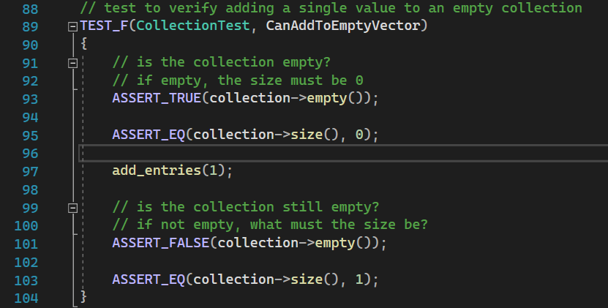
Unit Tests
CanAddToEmptyVector
This unit test verifies that adding objects to an empty container correctly results in the containers size being 1

Slide 10
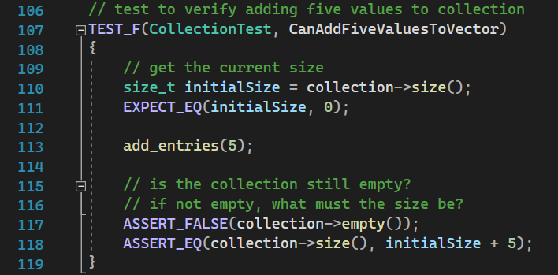
Unit Tests
CanAddFiveValuesToVector
This unit test verifies that adding five objects to an empty container correctly results in the containers size being 5 + initialSize

Slide 11
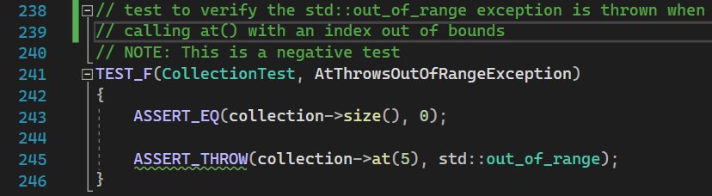
Unit Tests
AtThrowsOutOfRangeException
This unit test verifies that the at() method generates an std::out_of_range exception if an invalid index is accessed

Slide 12
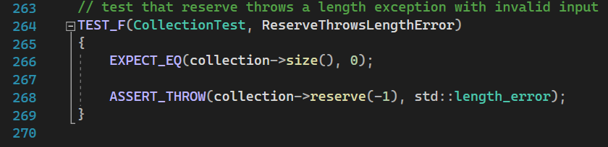
Unit Tests
ReserveThrowsLengthError
This unit test verifies that the reserve() method generates an std::length_error exception if an invalid amount of memory is requested

Slide 13

AUTOMATION SUMMARY
Automation is essential to enforcing compliance with the standards defined in this policy.
Automation tools like static and dynamic analyzers, input fuzzers, and penetration testers can be used to identify code that does not conform to the standards outlined in the policy.
These automation tools must be integrated into Green Paces' current pipeline in several different stages including building, verification and testing, and transition and health checks to move to a DevSecOps approach.

Slide 14
TOOLS
DevSecOps stands for development, security, and operations. It's an approach to culture, automation, and platform design that integrates security as a shared responsibility throughout the entire IT lifecycle (What Is DevSecOps?, n.d.).
Automation Tools
SonarQube: A static analyzer that should be used in the build stage to give developers feedback about the security, style, and performance of their code in real time as they write it.
sqlmap: A penetration testing tool that attempts to perform sql injection on an applications exposed endpoints. Should be incorporated into the verification and testing phase.
logentries: An accounting tool that can be used to log any number of system events and errors. Should be used in the monitor and detect stage.

Slide 15
RISKS AND BENEFITS
Prevent vulnerabilities
Improves the companies reputation both with customers and the industry by preventing security breaches
Saves money and time by fixing issues before they go into production
Requires refactoring of existing code
Increases the complexity and turnaround time of the current pipeline by including additional tools
Requires a greater level of knowledge and skill from developers to properly rectify non-compliant code
While refactoring existing code, tools, and pipelines to comply with the new security policies and standards does incur some risks, these are greatly outweighed by the benefits offered by a more secure system that can prevent far more damaging attacks and exploits.

Slide 16
RECOMMENDATIONS
This security policy provides the groundwork for creating secure systems. However, this policy does not cover everything, and several standards should be adopted to prevent future problems.
    This security policy has no standards concerning the use of 3rd party or open source libraries, APIs, and tools. Dependency vulnerabilities have resulted in exploits at Apple (Birsan, 2023). Additional standards and policies should be developed in order to ensure these external tools and dependencies are secure.
    This policy does not contain any standards regarding networks, servers, and other IT infrastructure and how to secure them. Unpatched vulnerabilities exist in many older NetGear routers (Toulas, 2024). Additional standards and policies should be developed in these areas.
    Additional standards, besides automation tools, for enforcing compliance with this policy should be developed. A security audit at HomeBrew recently uncovered 25 vulnerabilities (Arghire, 2024). Additional standards and policies should be developed to incorporate code reviews and regular security audits.

Slide 17
CONCLUSIONS
This security policy defines the core security principles and secure coding standards that support them. These principles and standards, in conjunction, create a defense in depth and greatly improve the quality and security of the system. While the policy provides a strong foundation, additional standards should be adopted that address the following.
Secure dependencies using automated tools.
Conduct manual code reviews to enforce compliance with secure coding standards.
Conduct regular security audits to ensure the system is functioning correctly and has not been breached.
Establish physical access control to server rooms.
Establish software access control to servers.
Regularly review security bulletins to ensure hardware (routers, network cards etc…) do not have vulnerabilities.

Slide 18
REFERENCES
Arghire, I. (2024, August 1). Homebrew Security Audit Finds 25 Vulnerabilities. Security Week. https://www.securityweek.com/homebrew-security-audit-finds-25-vulnerabilities/
Birsan, A. (2023, October 14). Dependency confusion: how I hacked into Apple, Microsoft and dozens of other companies. Medium. https://medium.com/@alex.birsan/dependency-confusion-4a5d60fec610
Toulas, B. (2024, June 10). Netgear WNR614 flaws allow device takeover, no fix available. BleepingComputer. https://www.bleepingcomputer.com/news/security/netgear-wnr614-flaws-allow-device-takeover-no-fix-available/
SQL injection used in Heartland, 7-Eleven and Hannaford breaches | AON. (2023, March 1). Aon. https://www.aon.com/cyber-solutions/aon_cyber_labs/sql-injection-used-in-heartland-7-eleven-and-hannaford-breaches/
What is DevSecOps? (n.d.). https://www.redhat.com/en/topics/devops/what-is-devsecops

